Slide 1
Chapter 9: Regression Analysis
Business Analytics: Methods, Models, and Decisions, 1st edition
James R. Evans

Slide 2
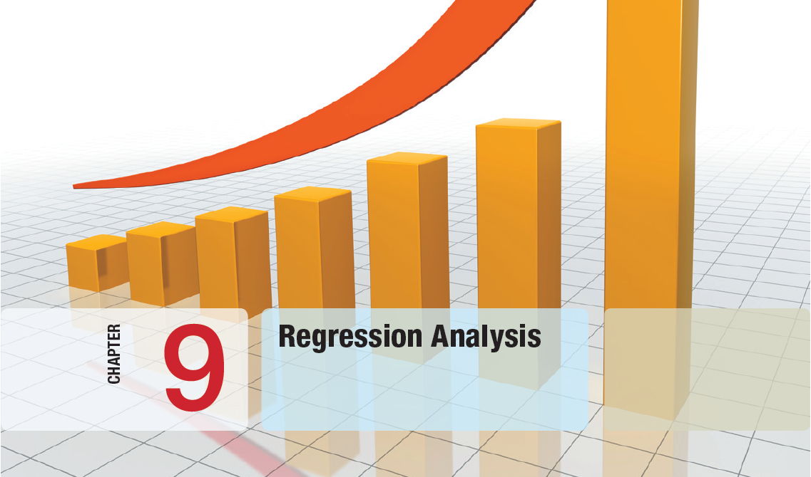

Slide 3
Chapter 9 Topics
Regression Analysis
Simple Linear Regression
Residual Analysis and Regression Assumptions
Multiple Linear Regression
Building Good Regression Models
Regression with Categorical Independent Variables
Regression Models with Nonlinear Terms

Slide 4
Regression Analysis
Regression analysis is a tool for building statistical models that characterize relationships among a dependent variable and one or more independent variables, all of which are numerical.
Simple linear regression involves a single independent variable.
Multiple regression involves two or more independent variables.

Slide 5
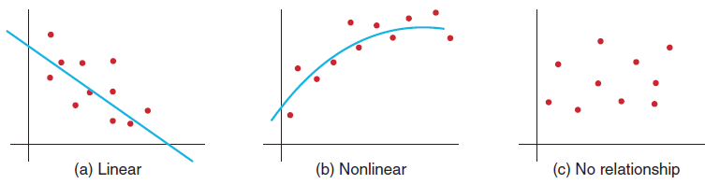
Simple Linear Regression
Finds a linear relationship between:
- one independent variable X and
- one dependent variable Y
First prepare a scatter plot to verify the data has a linear trend.
Use alternative approaches if the data is not linear.
Figure 9.1

Slide 6
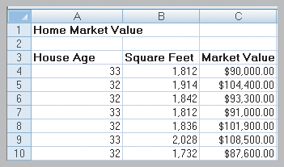
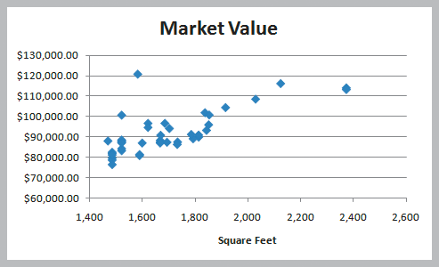
Simple Linear Regression
Example 9.1
Home Market Value Data
Size of a house is typically related to its market value.
X = square footage
Y = market value ($)
The scatter plot of the full data set (42 homes) indicates a linear trend.
Figure 9.2
Figure 9.3

Slide 7
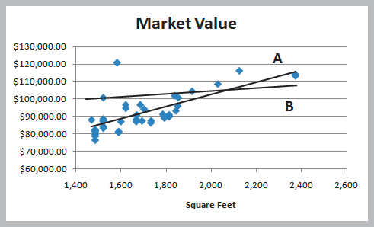
Simple Linear Regression
Finding the Best-Fitting Regression Line
Two possible lines are shown below.
Line A is clearly a better fit to the data.
We want to determine the best regression line.
Y = b₀ + b₁X
where
b₀ is the intercept
b₁ is the slope
^
Figure 9.4

Slide 8
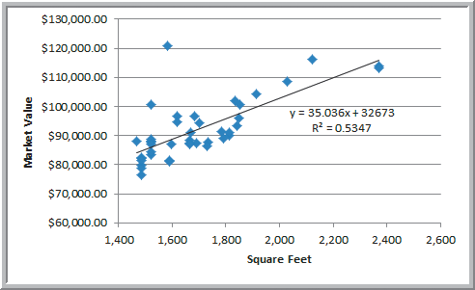
Simple Linear Regression
Example 9.2
Using Excel to Find the Best Regression Line
Market value = 32673 + 35.036(square feet)
The regression model explains variation in market value due to size of the home.
It provides better estimates of market value than simply using the average.
Figure 9.5

Slide 9
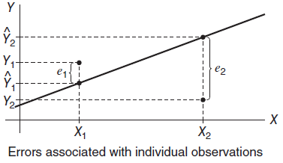
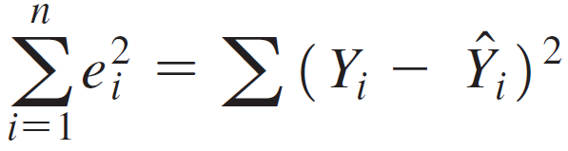
Simple Linear Regression
Least-Squares Regression
Using calculus we can solve for the slope and intercept of the least-squares regression line.
Regression analysis finds
the equation of the best-fitting line that minimizes
the sum of the squares of the observed errors (residuals).
Figure 9.6

Slide 10
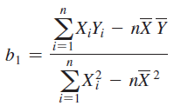

Simple Linear Regression
Least-Squares Regression Equations
Slope
b₁ =SLOPE(known ys, known xs)
Intercept
b₀ =INTERCEPT(known ys, known xs)
Predict Y for specified X values: Y = b₀ + b₁X
Y =TREND(known ys, known xs, new xs)
^
^

Slide 11
Simple Linear Regression
Example 9.3 Using Excel Functions to Find Least-Squares Coefficients
Slope = b₁ = 35.036
=SLOPE(C4:C45, B4:B45)
Intercept = b₀ = 32,673
=INTERCEPT(C4:C45, B4:B45)
Estimate Y when X = 1800 square feet
Y = 32,673 + 35.036(1800) = $95,737.80
=TREND(C4:C45, B4:B45, 1800)
Figure 9.2
^

Slide 12
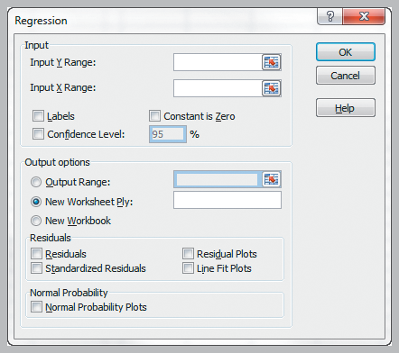
Simple Linear Regression
Excel Regression tool
Data
Data Analysis
Regression
Input Y Range
Input X Range
Labels
Excel outputs a table with many useful regression statistics.
Figure 9.7

Slide 13
Simple Linear Regression
Regression Statistics in Excel’s Output
Multiple R
| r | where r is the sample correlation coefficient
r varies from -1 to +1 (r is negative if slope is negative)
R Square
coefficient of determination, R²
varies from 0 (no fit) to 1 (perfect fit)
Adjusted R Square
adjusts R² for sample size and number of X variables
Standard Error
variability between observed & predicted Y variables

Slide 14
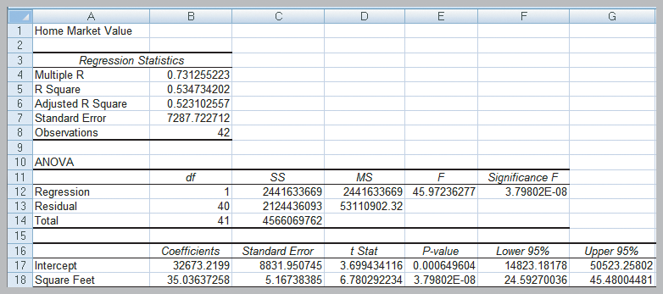
Simple Linear Regression
Example 9.4 Interpreting Regression Statistics for Simple Linear Regression (Home Market Value)
53% of the variation in home market values can be explained by home size.
The standard error of $7287 is less than standard deviation (not shown) of $10,553.
Figure 9.8

Slide 15
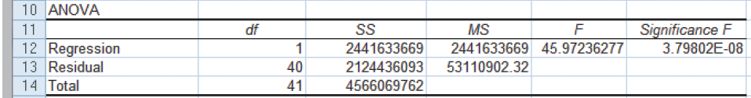
Simple Linear Regression
Regression Analysis of Variance
ANOVA conducts an F-test to determine whether variation in Y is due to varying levels of X.
ANOVA is used to test for significance of regression:
H₀: population slope coefficient = 0
H₁: population slope coefficient ≠ 0
Excel reports the p-value (Significance F).
Rejecting H₀ indicates that X explains variation in Y.
From Figure 9.8

Slide 16
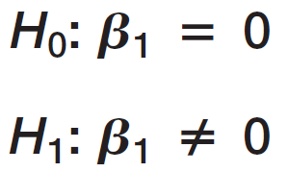
Simple Linear Regression
Example 9.5 Interpreting Significance of Regression
Home size is not a significant variable
Home size is a significant variable
p-value = 3.798 x 10⁻⁸
Reject H₀.
The slope is not equal to zero.
Using a linear relationship, home size is a significant variable in explaining variation in market value.
From Figure 9.8

Slide 17



Simple Linear Regression
Testing Hypotheses for Regression Coefficients
An alternate method for testing
is to use a t-test:
Excel provides the p-values for tests on the slope and intercept.
From Figure 9.8

Slide 18
Simple Linear Regression
Example 9.6 Interpreting Hypothesis Tests for Regression Coefficients (Home Market Value)
p-value for test on the intercept = 0.000649
p-value for test on the slope = 3.798 x 10⁻⁸
Both tests reject their null hypotheses.
Both the intercept and slope coefficients are significantly different from zero.
From Figure 9.8

Slide 19
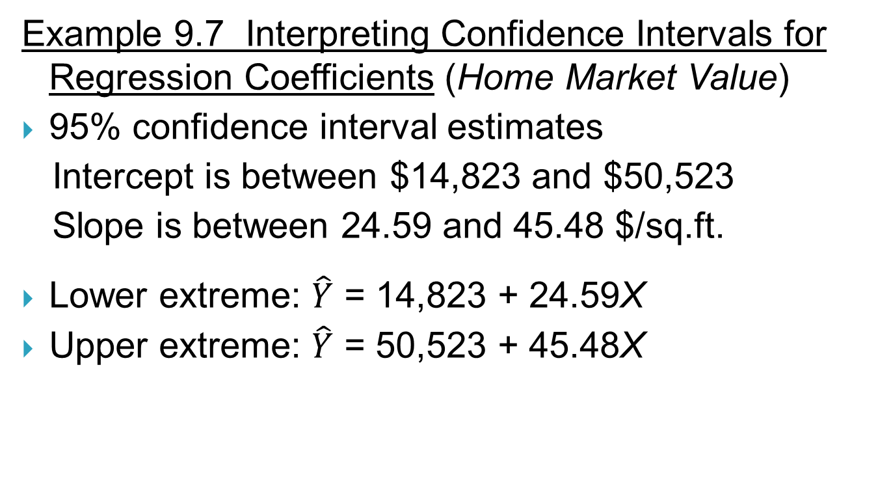
Simple Linear Regression
From Figure 9.8

Slide 20
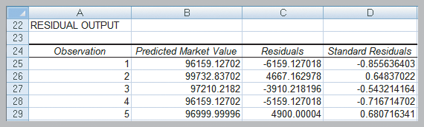
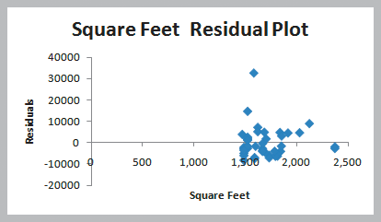
Residual Analysis and Regression Assumptions
Residual Analysis
Residuals are observed errors.
Residual = Actual Y value − Predicted Y value
Standard residual = residual / standard deviation
Rule of thumb: Standard residuals outside of ±2 or ±3 are potential outliers.
Excel provides a table and a plot of residuals.
Figure 9.9
Figure 9.10

Slide 21
Residual Analysis and Regression Assumptions
Example 9.8 Interpreting Residual Output
None of the residuals in the table of 5 homes shown below appear to be outliers.
In the full data set of 42 homes, there is a standardized residual larger than 4.
This small home may have a pool or unusually large piece of land.
Figure 9.9
Figure 9.3

Slide 22
Residual Analysis and Regression Assumptions
Checking Assumptions
Linearity
- examine scatter diagram (should appear linear)
- examine residual plot (should appear random)
Normality of Errors
- view a histogram of standard residuals
- regression is robust to departures from normality
Homoscedasticity
- variation about the regression line is constant
Independence of Errors
- successive observations should not be related

Slide 23
Residual Analysis and Regression Assumptions
Example 9.9 Checking Regression Assumptions for the Home Market Value Data
Linearity - linear trend in scatterplot
- no pattern in residual plot
Figure 9.3
Figure 9.10

Slide 24
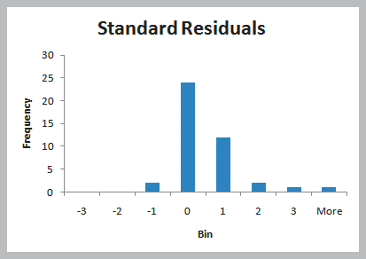
Residual Analysis and Regression Assumptions
Example 9.9 (continued) Checking Regression Assumptions for the Home Market Value Data
Normality of Errors – residual histogram appears slightly skewed but is not a serious departure
Figure 9.11

Slide 25
Residual Analysis and Regression Assumptions
Example 9.9 (continued) Checking Regression Assumptions for the Home Market Value Data
Homoscedasticity – residual plot shows no serious difference in the spread of the data for different X values.
Figure 9.10

Slide 26
Residual Analysis and Regression Assumptions
Example 9.9 (continued) Checking Regression Assumptions for the Home Market Value Data
Independence of Errors – Because the data is cross-sectional, we can assume this assumption holds.
All 4 regression assumptions are reasonable for the Home Market Value data.

Slide 27
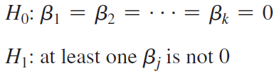
Multiple Linear Regression
Multiple Regression has more than one independent variable.
The multiple linear regression equation is:
The ANOVA test for significance of the entire model is:
One can also test for significance of individual regression coefficients.

Slide 28
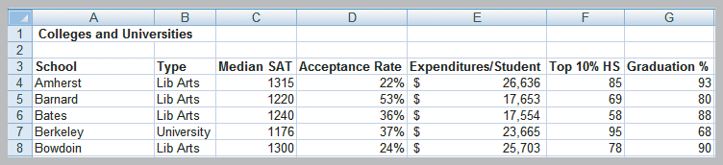
Multiple Linear Regression
Example 9.10 Interpreting Regression Results for the Colleges and Universities Data
Colleges try to predict student graduation rates using a variety of characteristics, such as:
1. Median SAT 3. Acceptance rate
2. Expenditures/student 4. Top 10% of HS class
Y
Figure 9.12

Slide 29
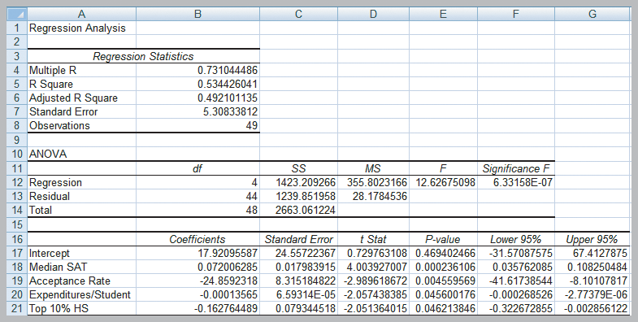

Multiple Linear Regression
Example 9.10 (continued) Interpreting Regression Results for the Colleges and Universities Data
Figure 9.13

Slide 30
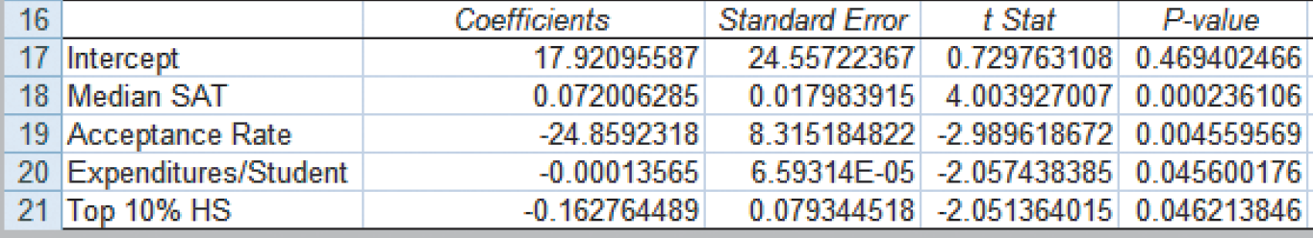
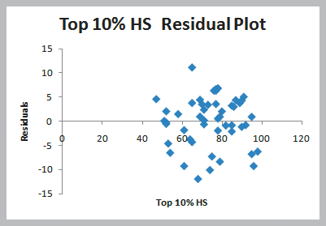
Multiple Linear Regression
Example 9.10 (continued) Interpreting Regression Results for the Colleges and Universities Data
All of the slope coefficient p-values are < 0.05.
From Figure 9.13
The residual plots (only one shown here) show random patterns about 0.
Normal probability plots (not shown) also validate assumptions.
Figure 9.14

Slide 31

Multiple Linear Regression
Analytics in Practice:
Using Linear Regression and
Interactive Risk Simulators to
Predict Performance at ARAMARK
ARAMARK, located in Philadelphia, is an award-winning provider of professional services
They developed an on-line tool called “interactive risk simulators” (shown on next slide) that allows users to change various business metrics and immediately see the results.
The simulators use linear regression models.

Slide 32
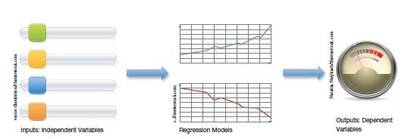
Multiple Linear Regression
Analytics in Practice: (ARAMARK continued)
Risk metrics are adjusted using sliders.
Allows users (managers and directors) to see the impact of these risks on the business.
Figure 9.15

Slide 33
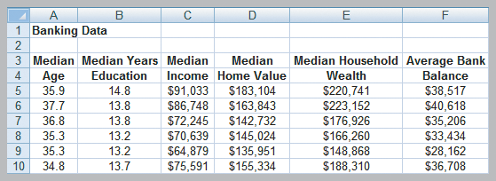
Building Good Regression Models
All of the independent variables in a linear regression model are not always significant.
We will learn how to build good regression models that include the “best” set of variables.
Banking Data includes demographic information on customers in the bank’s current market.
Y
Figure 9.16

Slide 34
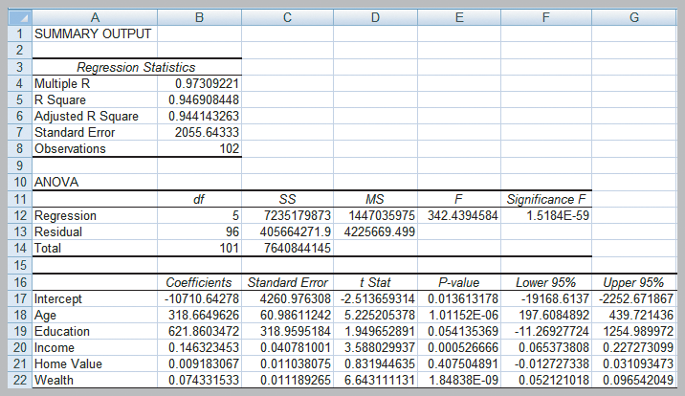
Building Good Regression Models
Predicting Average Bank Balance using Regression
Home Value and Education are not significant.
Figure 9.17

Slide 35
Building Good Regression Models
Systematic Approach to Building Good Multiple Regression Models
1. Construct a model with all available independent
variables and check for significance of each.
2. Identify the largest p-value that is greater than α.
3. Remove that variable and evaluate adjusted R².
4. Continue until all variables are significant.
→ Find the model with the highest adjusted R².
(Do not use unadjusted R² since it always
increases when variables are added.)

Slide 36
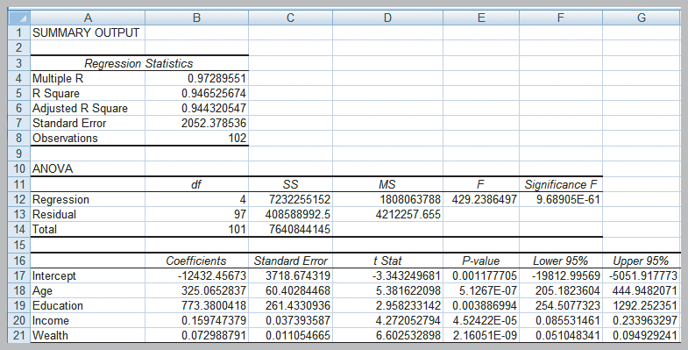
Building Good Regression Models
Example 9.11
Identifying the Best Regression Model
Bank regression after removing Home Value
Adjusted R² improves slightly.
All X variables are significant.
Figure 9.18

Slide 37
Building Good Regression Models
Multicollinearity
- occurs when there are strong correlations among
the independent variables
- makes it difficult to isolate the effects of
independent variables
- signs of slope coefficients may be opposite of the
true value and p-values can be inflated
Correlations exceeding ±0.7 are an indication that multicollinearity might exist.
Variance Inflation Factors are a better indicator.
Parsimony is an age-old principle that applies here.

Slide 38
Building Good Regression Models
Example 9.12
Identifying Potential Multicollinearity
Colleges and Universities (full model)
Full model
Adjusted R² = 0.4921
Figure 9.13

Slide 39
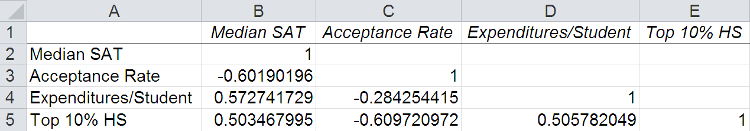
Building Good Regression Models
Example 9.12 (continued)
Identifying Potential Multicollinearity
Correlation Matrix (Colleges and Universities data)
All of the correlations are within ±0.7
Signs of the coefficients are questionable for Expenditures and Top 10%.
From Figure 9.19

Slide 40
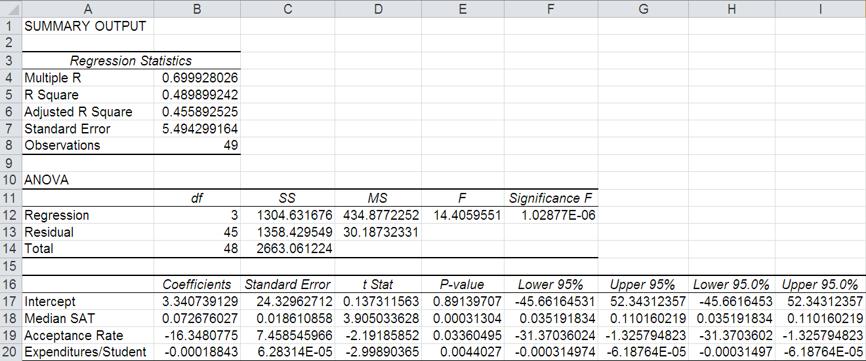
Building Good Regression Models
Example 9.12 (continued)
Identifying Potential Multicollinearity
Colleges and Universities (reduced model)
Dropping Top 10%
Adjusted R² drops to 0.4559

Slide 41
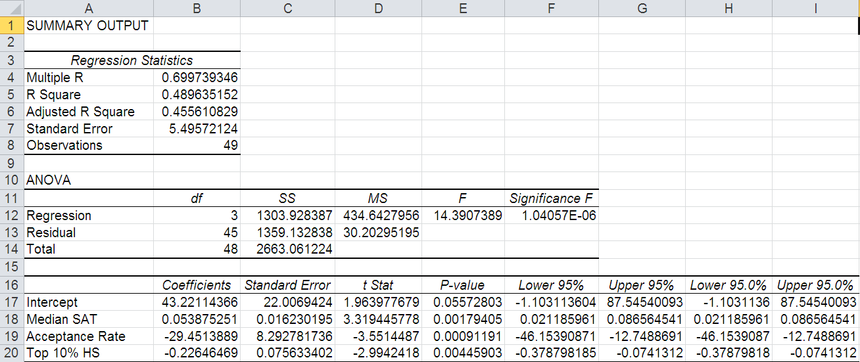
Building Good Regression Models
Example 9.12 (continued)
Identifying Potential Multicollinearity
Colleges and Universities (reduced model)
Dropping Expenditures
Adjusted R² drops to 0.4556

Slide 42
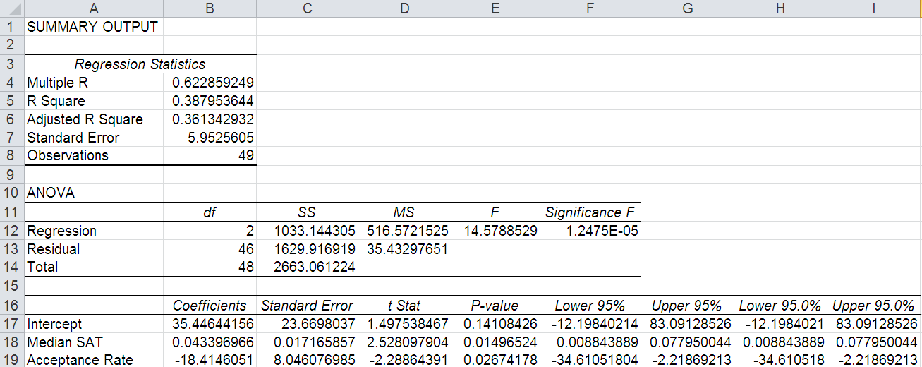
Building Good Regression Models
Example 9.12 (continued)
Identifying Potential Multicollinearity
Colleges and Universities (reduced model)
Dropping Expenditures and Top 10%
Adjusted R² drops to 0.3613
Which of the 4 models would you choose?

Slide 43
Building Good Regression Models
Example 9.12 (continued)
Banking Data (full model)
Full Model
Adjusted R² = 0.9441
Education and Home Value
are not significant.
Figure 9.17

Slide 44
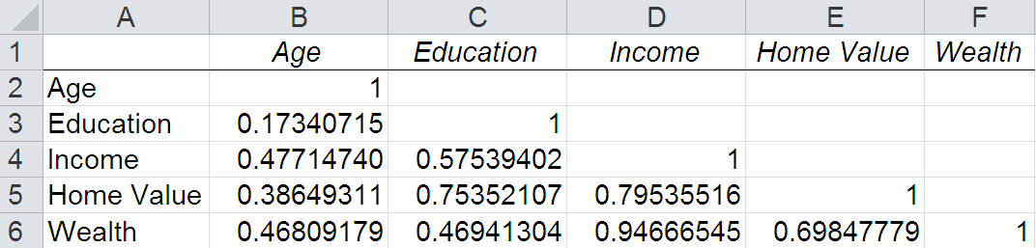
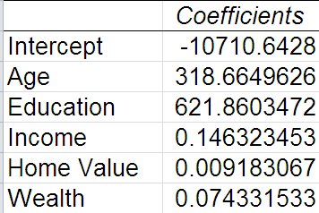
Building Good Regression Models
Example 9.12 (continued)
Identifying Potential Multicollinearity
Correlation matrix for the Banking data
Some of the correlations exceed 0.7 for Home Value and Wealth.
Signs of the coefficients for predicting bank balance are as expected (positive).
From Figure 9.20
From Figure 9.17

Slide 45
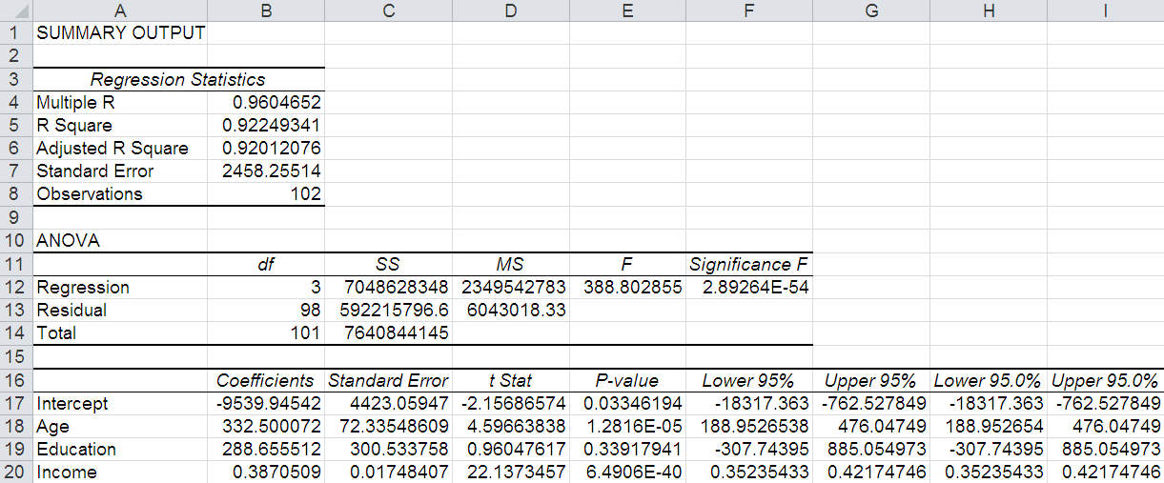
Building Good Regression Models
Example 9.12 (continued)
Banking Data (reduced model)
Dropping Wealth and Home Value
Adjusted R² drops to 0.9201
Education is not significant.

Slide 46
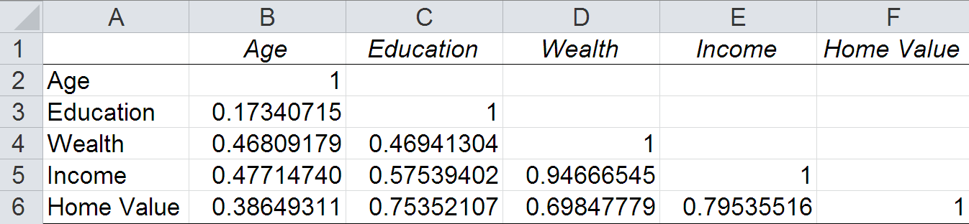
Building Good Regression Models
Example 9.12 (continued)
Identifying Potential Multicollinearity
Re-ordered Correlation matrix for Banking data
By re-ordering the variables, we can see the correlations for Age, Education, and Wealth are all within ± 0.7.
Let’s try a reduced model with the Age, Education, and Wealth variables.
From Figure 9.20

Slide 47
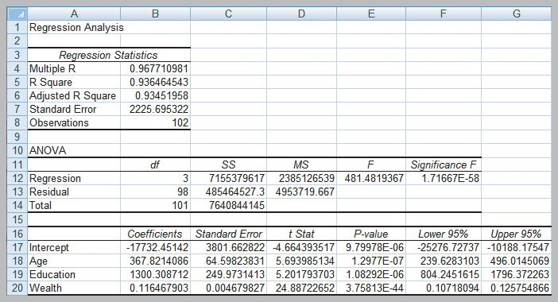
Building Good Regression Models
Example 9.12 (continued)
Banking Data (reduced model) ** best model
Dropping Income and Home Value.
Adjusted R² = 0.9345.
All variables are significant. Multicollinearity is not a problem.
Figure 9.21

Slide 48
Regression with Categorical Variables
Dealing with Categorical Variables
Must be coded numeric using dummy variables.
For variables with 2 categories, code as 0 and 1.
For variables with k ≥ 3 categories, create k−1 binary (0,1) variables.
Interaction Terms
A dependence between two variables is called interaction.
Test for interaction by adding a new term to the model, such as X₃ = X₁X_{2.}

Slide 49
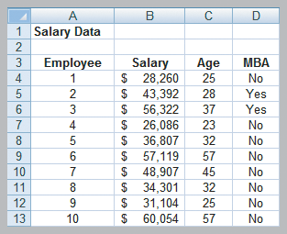
Regression with Categorical Variables
Example 9.13 A Model with Categorical Variables
Employee Salaries provides data for 35 employees
Predict Salary using Age and MBA (yes=1, no=0)
Figure 9.22

Slide 50
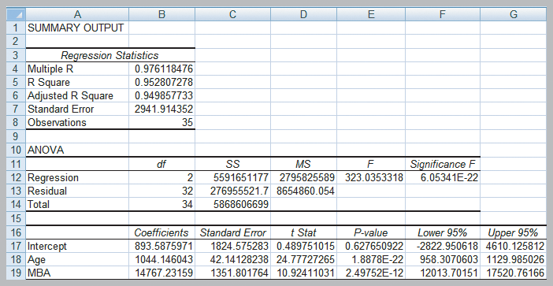
Regression with Categorical Variables
Example 9.13 (continued)
Salary = 893.59 + 1044(Age) for those without MBA
Salary =15,660.82 + 1044(Age) for those with MBA
Adjusted R² = 0.949858
Figure 9.23

Slide 51
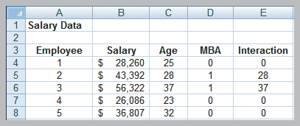
Regression with Categorical Variables
Example 9.14 Incorporating Interaction Terms in a Regression Model
Define an interaction between Age and MBA and include in the regression model.
Interaction = (Age)(MBA)
Figure 9.24

Slide 52
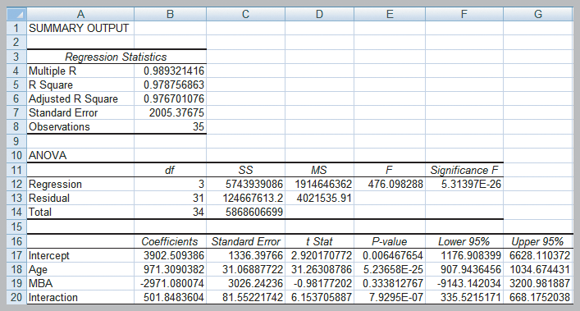
Regression with Categorical Variables
Example 9.14 (continued) Incorporating Interaction Terms in a Regression Model
MBA is now insignificant so we will drop it from the model.
Adjusted R² = 0.976701
Figure 9.25

Slide 53
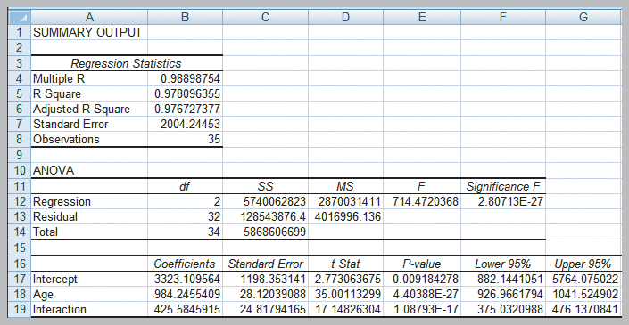
Regression with Categorical Variables
Example 9.14 (continued)
Salary = 3,323 + 984(Age) for those without MBA
Salary = 3,323 + 1410(Age) for those with MBA
Adjusted R² = 0.976727
(a slight improvement)
Figure 9.26

Slide 54
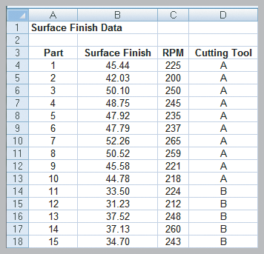
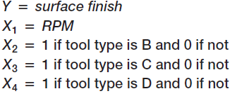
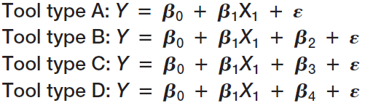
Regression with Categorical Variables
Example 9.15 A Regression Model with Multiple Levels of Categorical Variables
Surface Finish data provides measurements for 35 parts produced on a lathe.
Figure 9.27

Slide 55
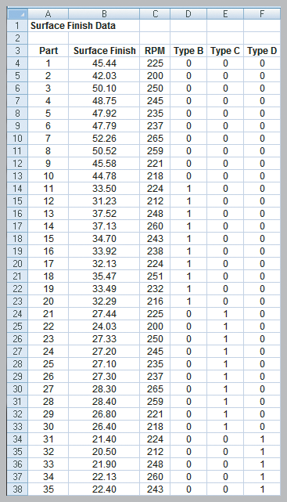
Regression with Categorical Variables
Example 9.15 (continued)
A Regression Model with
Multiple Levels of
Categorical Variables
Tool Type (A,B,C,D) is now
coded as 3 dummy variables
Figure 9.28

Slide 56
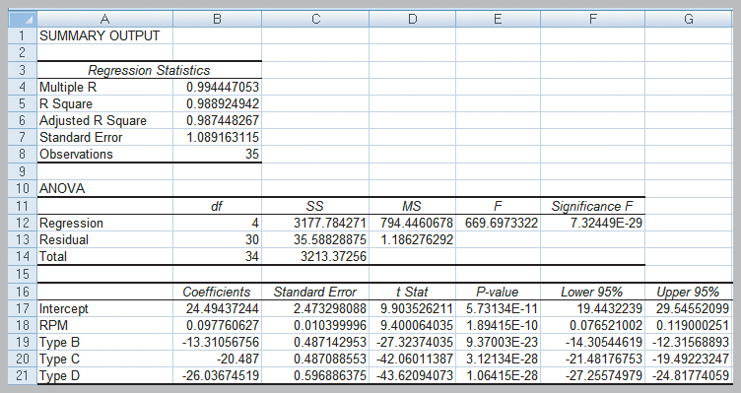
Regression with Categorical Variables
Example 9.15 (continued) A Regression Model with Multiple Levels of Categorical Variables
Tool A: Surf. Finish = 24.5 + 0.098 RPM
Tool B: Surf. Finish = 11.2 + 0.098 RPM
Tool C: Surf. Finish = 4.0 + 0.098 RPM
Tool D: Surf. Finish = -1.6 + 0.098 RPM
Figure 9.29

Slide 57
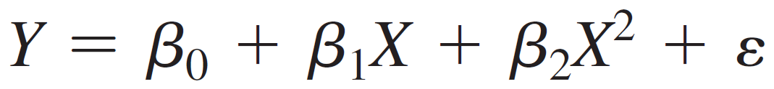
Regression Models with Nonlinear Terms
Curvilinear Regression
Curvilinear models may be appropriate when scatter charts or residual plots show nonlinear relationships.
A second order polynomial might be used
Here β₁ represents the linear effect of X on Y and β₂ represents the curvilinear effect.
This model is linear in the β parameters so we can use linear regression methods.

Slide 58
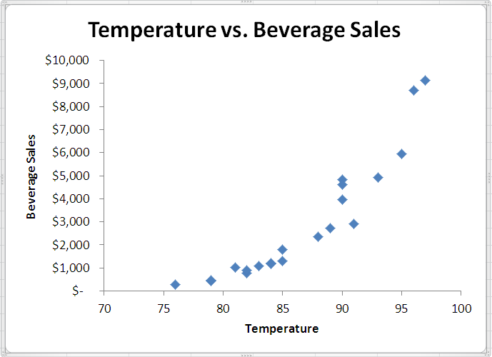
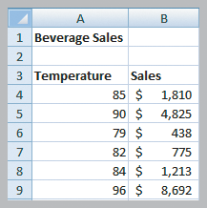
Regression Models with Nonlinear Terms
Example 9.16 Modeling Beverage Sales Using Curvilinear Regression
Sales of cold beverages increase when it is hotter outside.
Figure 9.30

Slide 59
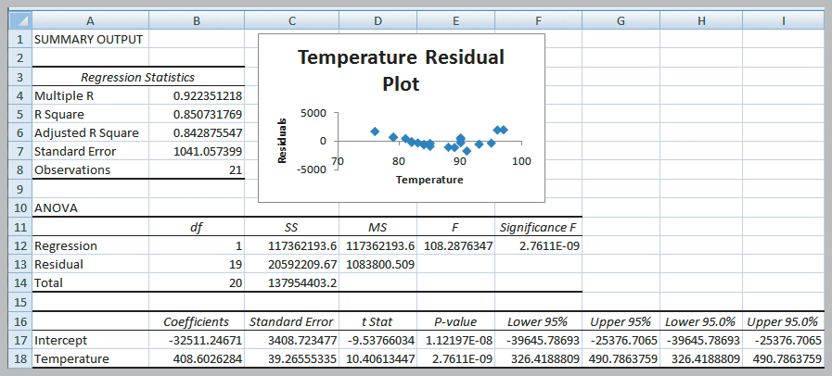
Regression Models with Nonlinear Terms
Example 9.16 (continued) Modeling Beverage Sales Using Curvilinear Regression
U-shape residual plot
Figure 9.31

Slide 60
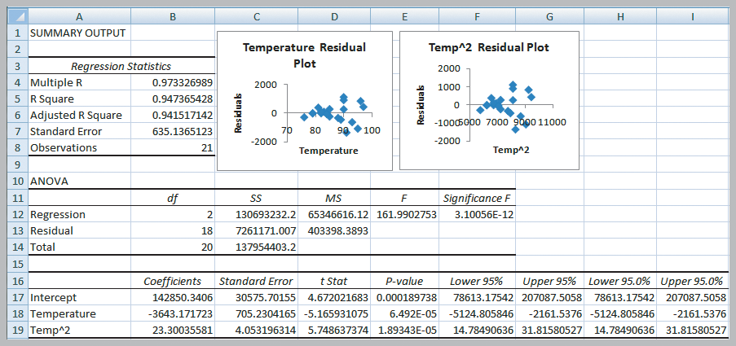
Regression Models with Nonlinear Terms
Example 9.16 (continued) Modeling Beverage Sales Using Curvilinear Regression
Residual pattern is more random
Sales = 142,850
−3643(temperature)
+ 23.3(temperature)²
Figure 9.32

Slide 61

Regression Models with Nonlinear Terms
Example 9.16 (continued) Modeling Beverage Sales Using Curvilinear Regression
Second Order Polynomial Trendline

Slide 62
Chapter 9 - Key Terms
Autocorrelation
Coefficient of determination
Coefficient of multiple determination
Curvilinear regression model
Dummy variables
Homoscedasticity
Interaction
Least-squares regression
Mulitcollinearity
Multiple correlation coefficient

Slide 63
Chapter 9 - Key Terms (continued)
Multiple linear regression
Parsimony
Partial regression coefficient
Regression analysis
Residuals
Significance of regression
Simple linear regression
Standard error of the estimate
Standard residuals

Slide 64
Case Study Performance Lawn Equipment (9)
Recall that PLE produces lawnmowers and a medium size diesel power lawn tractor.
Predict what might have happened if PLE never implemented the 2009 defect reduction initiative.
Determine the effect of education, GPA, and age when hired on employee retention.
Investigate the rate of learning following the implementation of the new production technology.
Write a formal report summarizing your results.

Slide 65


